Slide 1

Youth Night Agenda
Introduction
2026 Youth Coaches
Safeguarding in Cricket
Coaching expectations
Player expectations
Kit & Equipment requirements
Membership Fees
Play Cricket
ClubSport365
Questions from the floor.

Slide 2
2026 Youth Coaches
Head Youth Coach – Simon Gregory / Callum James
U9s (Softball) – Emma & Alex Bingham
U10s (Hardball) - Greg Siddell
U11s (Hardball) - Ben Shorter
U12s (Hardball) – Carl Bust
U13s (Hardball) – Alex Mezzone
U14s (Hardball) - Alex Mezzone
U15s (Hardball) - Alex Mezzone (Parent Assisted)
U17s (Hardball) - Joe Doyle (Cal James Assisted)
U19s (Hardball) - Cal James
Girls Cricket (Softball & Hardball) – Ciaran Baker-Smith

Slide 3
Safeguarding in Cricket
ECB Cricket Regulator Safeguarding Team provides a reactive and proactive element to Safeguarding. The Case Management Team manage referrals and investigations when a safeguarding concern has been raised
County Safeguarding Officers are appointed by each County Cricket Board to provide advice and assistance on safeguarding for clubs, leagues and other affiliated organization's within each county
Club Safeguarding Officers - Whilst everyone is responsible for safeguarding, the Club Safeguarding Officer will make sure the appropriate policies and procedures are in place, and that everyone in regulated activity at their club, is vetted by the ECB/Cricket Regulator. They are the go-to person that others come to if they have concerns, and having attended specific training, will know what to do in order to assist, or who to ask for further help.
Halesowen Cricket Club Safeguarding Officers are Audrey Baker-Smith and Carl Bust

Slide 4
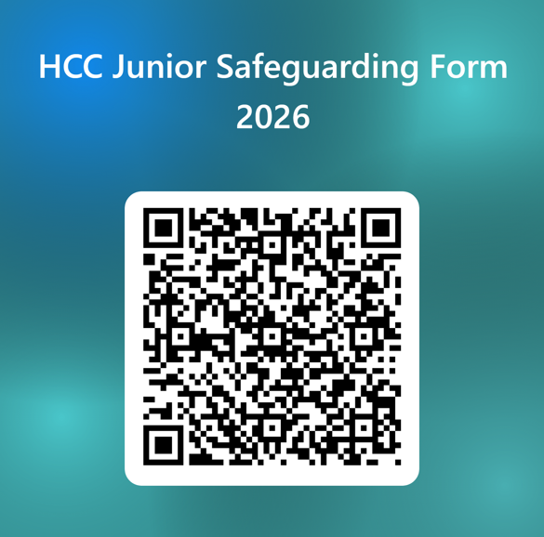
Safeguarding Form
HCC Junior Safeguarding Form 2026 – Fill in form

Slide 5
Coaching Expectations
Ensure cricket is welcoming, fun, enjoyable, and that fair play is promoted
Aim to provide appropriate experiences and activities for players at all stages of their cricketing journey
Prioritize player well-being, safety, and enjoyment, while also focusing on skill development and maintaining high standards
Sets and consistently reinforces clear expectations of behavior during training and matches.

Slide 6
Player Expectations
Have fun
Train and play cricket in a spirit of fun
Work hard
Give 100% effort during training and matches (whether winning or losing)
Be Encouraging to all players on the pitch
Be good
Play within the rules
Respect (don’t argue with) coaches, team managers, umpires, scorers and other players
Be kind and polite to everyone at all times

Slide 7
Equipment & Kit Requirements
Equipment Requirements
Helmet
Batting Leg Guards
Batting Gloves
Abdo Guard (Box)
Cricket Bat
Kit Requirements
White Cricket Top
White Cricket Trousers
Appropriate footwear (cricket spikes or pimples recommended)
Training tops to be provided as part of membership

Slide 8
Equipment & Kit Requirements
Neck Protection / Angel Wings
The ECB have issued new guidance on the use of neck protection on helmets.
Although not mandatory in recreational cricket, the ECB are strongly recommending that this guidance is adopted by others in the cricket community.

Slide 9

Training Kit Order Form
As part of youth registration fee’s each child will receive a training
top. Please use the below form to place your order
2026 Training Top Order – Fill in form

Slide 10
Membership Fees
Senior Membership £26
Adult Social Member £47
Playing Adult (Male) £163
Playing Student £109
Playing Adult Female £47
Youth Softball U9 £79 (Sibling Discount 50%)
Youth Hardball U10 – U16 £96 (Sibling Discount 50%)

Slide 11
Play Cricket
All players will be required to register on play cricket. Play Cricket provides a platform for managing players, scoring and automatic publication of results, tables and statistics
Play-Cricket - Registration
Play Cricket Sign Up Process - Joining a Club - Parents, Guardians and Children – Play-Cricket
Play-Cricket Live on the App Store

Slide 12
Clubsport365
All players will be required to register on Clubsport365. Clubsport365 will be used for payment of match fees, availability and team selection.
ClubSports365 - Ultimate Sports Club Management Software
ClubSports365 on the App Store

Slide 13

Date for your Diary
This year the annual Get Set Weekend is scheduled for 28th & 29th March 2026.
We will also be holding a kit amnesty on the Sunday, where you can pick up some pre-loved kit for a donation to the club. Donations of kit are greatly appreciated.

